Slide 1
Exit Routes Emergency Action Plans Fire Prevention Plans Fire Protection

Slide 2
Objectives
Design and construction requirements for exit routes
Maintenance , safeguards, and operational features for exit routes
Emergency action plans
Fire prevention plans
Fire protection

Slide 3
OSHA Requires
Employers to provide proper exits
Fire fighting equipment
Employee training
Why are we here today?
Notes:
All above are required to prevent fire deaths and injuries in the workplace

Slide 4
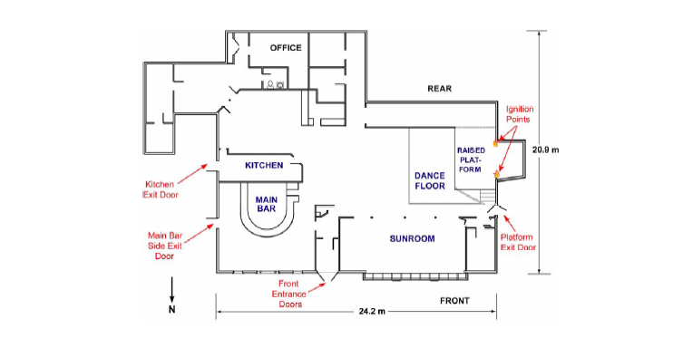
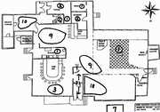
Lessons learned
December 31, 2004 Argentina club fire kills 175
April 27, 2008 Morocco Mattress Factory kills 55
February 20, 2003 Rhode Island Station nightclub kills 100

Slide 5
Exits Routes
An exit must be permanent
An exit must be seperated by fire resistant materials
Openings into an exit must be limited
The number of exits must be adequate

Slide 6
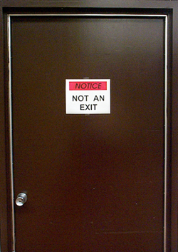
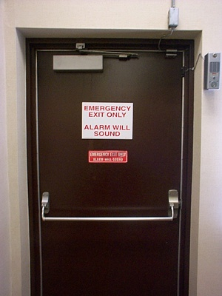
Exit door must be unlocked
A side-hinged exit door must be used
Capacity of an exit route must be adequate
Exit route minimum height and width

Slide 7
Safeguards
Dangers to employees must be minimized
Lighting and Marking
Exit routes must be maintained
Alarm system must be operable

Slide 8
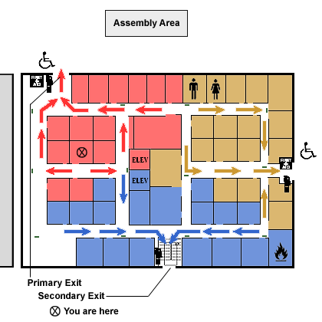
Emergency action plans
Written and oral emergency action plans
What elements make up an emergency action plan?
Reporting
Critical operations
Accounting for employees
Review of plan

Slide 9
Fire prevention plans
List of all major fire hazards
Controlling accumulations of flammable and combustible waste materials
Maintenance to eliminate ignition
Who’s responsible for maintaining equipment

Slide 10
Fire Protection
The employer is responsible for providing portable fire extinguishers
Requirements
Types, locations, inspections, and training

Slide 11
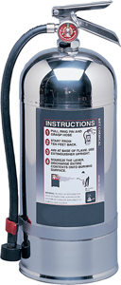
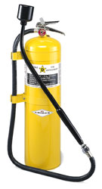

Slide 12
Fire extinguishers provided
General principles of fire extinguisher use
Hazards of incipient (beginning) stage fire fighting
Employees designated to use extinguishers must receive instruction and hands-on practice in the operation of equipment

Slide 13
Portable Fire Extinguishers
Extinguishers shall be distributed so that maximum travel distances apply:
Class A 75 feet
Class B 50 feet
Class C Based on appropriate pattern
Class D 75 feet

Slide 14
Quiz
What is a Class A fire?
A magnesium fire requires, what type fire extinguisher?
What is the maximum travel distance to a Class B fire extinguisher?

Slide 15
Summary
There must be enough exits in the proper arrangement for quick escape
Exit routes must be marked, lighted, free of obstructions, and locks must not be used to impede or prevent escape
An emergency action plan and a fire prevention plan must be in place

Slide 16
Summary
Fire extinguisher classes and numerical ratings help a user understand its capabilities
Fire extinguishers must be inspected, maintained and employees must be trained in how to use them

Slide 17
Training Resources
National Fire Protection Association (NFPA)
1-800-344-3555
www.nfpa.org

